Slide 1
Panel Discussion 1: Fundamentals of Hydrogen Energy and Carbon Capture
Nate Weiland, Senior Fellow
National Energy Technology Laboratory
Harnessing Hydrogen: Exploring Local & Regional Opportunities in Appalachia
A Symposium Hosted by W&J Center for Energy Policy and Management
October 4th, 2022

Slide 2
Today’s Goals
1. Define what hydrogen is and why it is important
2. Introduce Appalachian Hydrogen Hub Opportunities
2

Slide 3
Administration Priorities
2030 –
2035 –
–
2050 –
50-52 percent reduction in economy-wide new greenhouse gas pollution from 2005 levels
Carbon pollution-free electricity sector
Address environmental justice and job creation
Zero-carbon economy
Hydrogen is essential to meet ambitious GHG and zero-carbon economy goals
Advanced hydrogen technology development: job creation in multiple sectors

Slide 4
What is Hydrogen?
Most abundant element in the universe
Clean and flexible energy carrier
Produced from diverse domestic resources
Many applications
4
Notes:
Hydrogen is the simplest element known, the lightest of all gases, and the most abundant element in the universe.
Set stage. Remind everyone what hydrogen is and how it stands alone on the periodic table.
Lightest of all gases
Versatile, clean and flexible energy carrier
Produced from diverse domestic resources and
Used in many applications

Slide 5
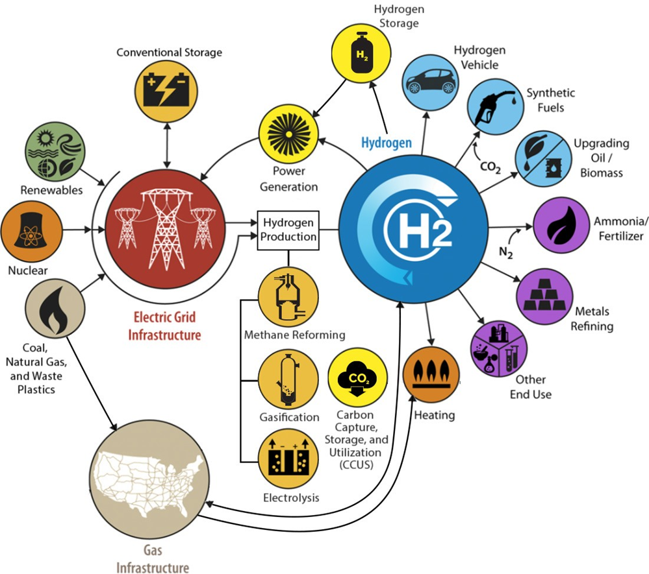
Hydrogen Economy
Hydrogen: the Swiss Army Knife of Clean Energy
Notes:
Reference: https://www.energy.gov/sites/default/files/2017/03/f34/fcto-overview-flyer-nov2017.pdf
Spend a minute here to orient audience to how all fits together.
(left) Energy Source & Feedstock
Hydrogen can be produced from multiple energy sources that are abundant in the United States:
Most of today’s hydrogen comes from fossil fuels, especially natural gas and also coal
Nuclear power
Renewable resources like wind, solar, geothermal, and biomass
(middle) Production
You can couple any of these energy sources with a few processes to produce hydrogen.
Most of today’s hydrogen is produced from natural gas through a process called steam methane reforming.
Steam and hydrocarbons come together under high temperature to produce hydrogen.
This happens in a xxx.
In gasification, carbonaceous feedstocks react yielding hydrogen-rich synthesis gas.
Layperson’s terms?
You can also use electricity to separate water into oxygen and hydrogen, called electrolysis.
Then you transport and store the Hydrogen
Like a battery, hydrogen can store energy and it can do so in large quantities and for a long time.
So, you could use any excess energy from renewable power that the grid cannot take and store it as hydrogen until you need to use it.
(right) Utilization
There are lots of end uses for hydrogen….
Most of what’s produced in the United States is used for petroleum refining, followed by industries in the chemical space.
However, applications in transportation, stationary power, and energy storage are emerging rapidly.
Hydrogen can be used in fuel cells for transportation applications like passenger cars, buses, trucks, and forklifts;
And for stationary power for buildings and facilities across the country including cell phone towers, data centers, hospitals, supermarkets, and many more.

Slide 6
Present Day Hydrogen Sources
Hydrogen from Coal via Gasification
Hydrogen from Natural Gas via:
Steam Methane Reforming (SMR)
Other types of reforming
Both production methods currently produce significant CO₂ emissions
BIOMASS
NUCLEAR & WATER
SOLAR & WATER
WIND & WATER
COAL
SHARE OF GLOBAL ENERGY PRODUCTION
NATURAL GAS

Slide 7
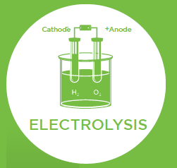
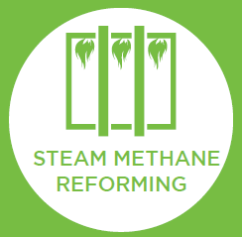
Many Ways to Produce Hydrogen
Most of today’s hydrogen is produced through steam methane reforming
GASIFICATION
Electricity separates water into oxygen and hydrogen
Energy from direct sunlight and sun heat splits molecules
Carbonaceous feedstocks react yielding hydrogen-rich synthesis gas
Steam and hydrocarbons come together under high temperature
Image source: U.S. DOE Fuel Cell Technologies Office
Notes:
You can use any energy source we saw earlier and couple it with the processes you see here to produce hydrogen.
For example, most of today’s hydrogen is produced from natural gas through a process called steam methane reforming.
This is where steam and hydrocarbons come together under high temperature to produce hydrogen.
You can also use power from renewable sources to generate electricity, which you then couple with water to produce hydrogen through a process called electrolysis.
In electrolysis, you apply an electric current to water and split it into oxygen and hydrogen.
You can also bypass the electricity step and use direct sunlight to produce hydrogen in a process called photoelectrochemical hydrogen production.

Slide 8
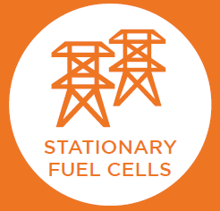
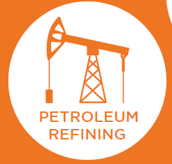
Multiple Uses for Hydrogen
Hydrogen can be used in many sectors throughout the economy
Including mobile applications like buses, trucks, and forklifts
Good for limiting renewable power curtailing and stabilizing grid
Interest from cell towers, data centers, hospitals, supermarkets
Largest use of hydrogen today
2nd largest use of hydrogen today
Image source: U.S. DOE Fuel Cell Technologies Office
Notes:
As we saw earlier, most of the hydrogen we produce in the United States is used for petroleum refining, followed by industries in the chemical space.
However, applications in transportation, stationary power, and energy storage are emerging rapidly.
Hydrogen can be used in fuel cells for transportation applications like passenger cars, buses, trucks, and forklifts;
And for stationary power for buildings and facilities across the country including cell phone towers, data centers, hospitals, supermarkets, and many more.
Like a battery, hydrogen has the ability to store energy and it can do so in large quantities and for a long time.
So you could use any excess energy from renewable power that the grid cannot take and store it as hydrogen until you need to use it.

Slide 9
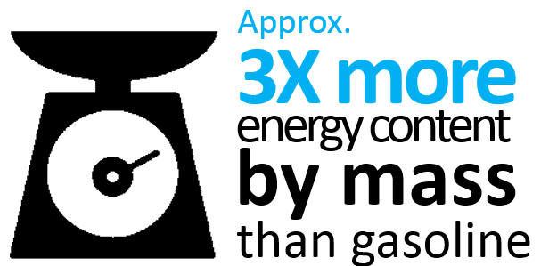
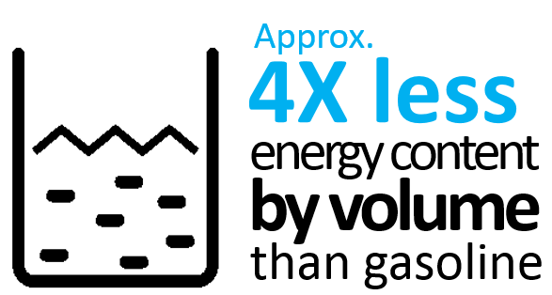
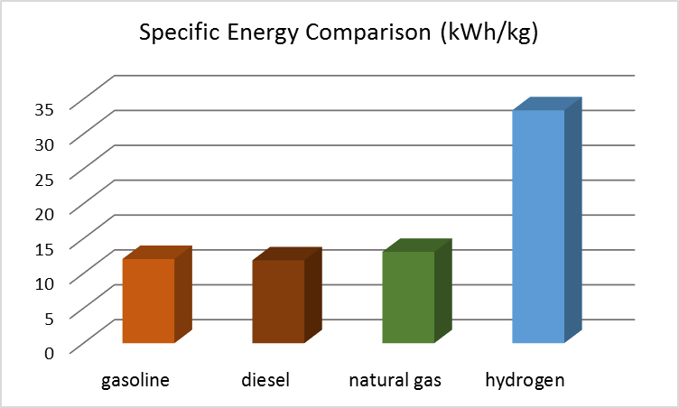
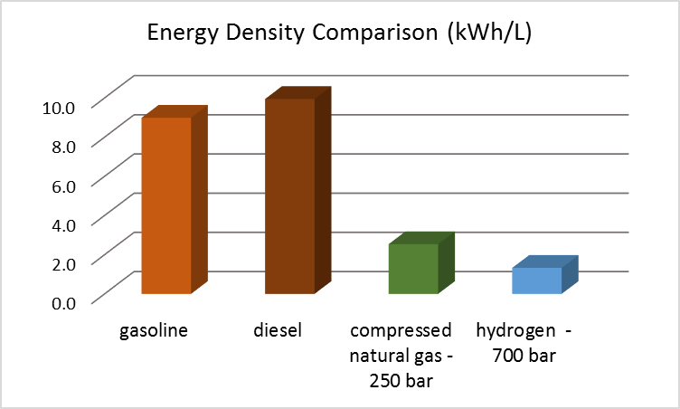
Hydrogen Challenges—Energy Density
High energy by mass, low energy by volume
Image source: U.S. DOE Fuel Cell Technologies Office
Notes:
Hydrogen has the highest energy content of all known conventional fuels on mass basis (by weight it has almost 3 times more energy content than gasoline).
But it is the other way around when you look at energy density (hydrogen has approximately 4 times less energy content by volume than gasoline).
This means you need a lot of space to store it; this makes storing hydrogen difficult especially in applications where space is at a premium.
Low-cost/improved hydrogen storage technology is therefore of ongoing interest.

Slide 10
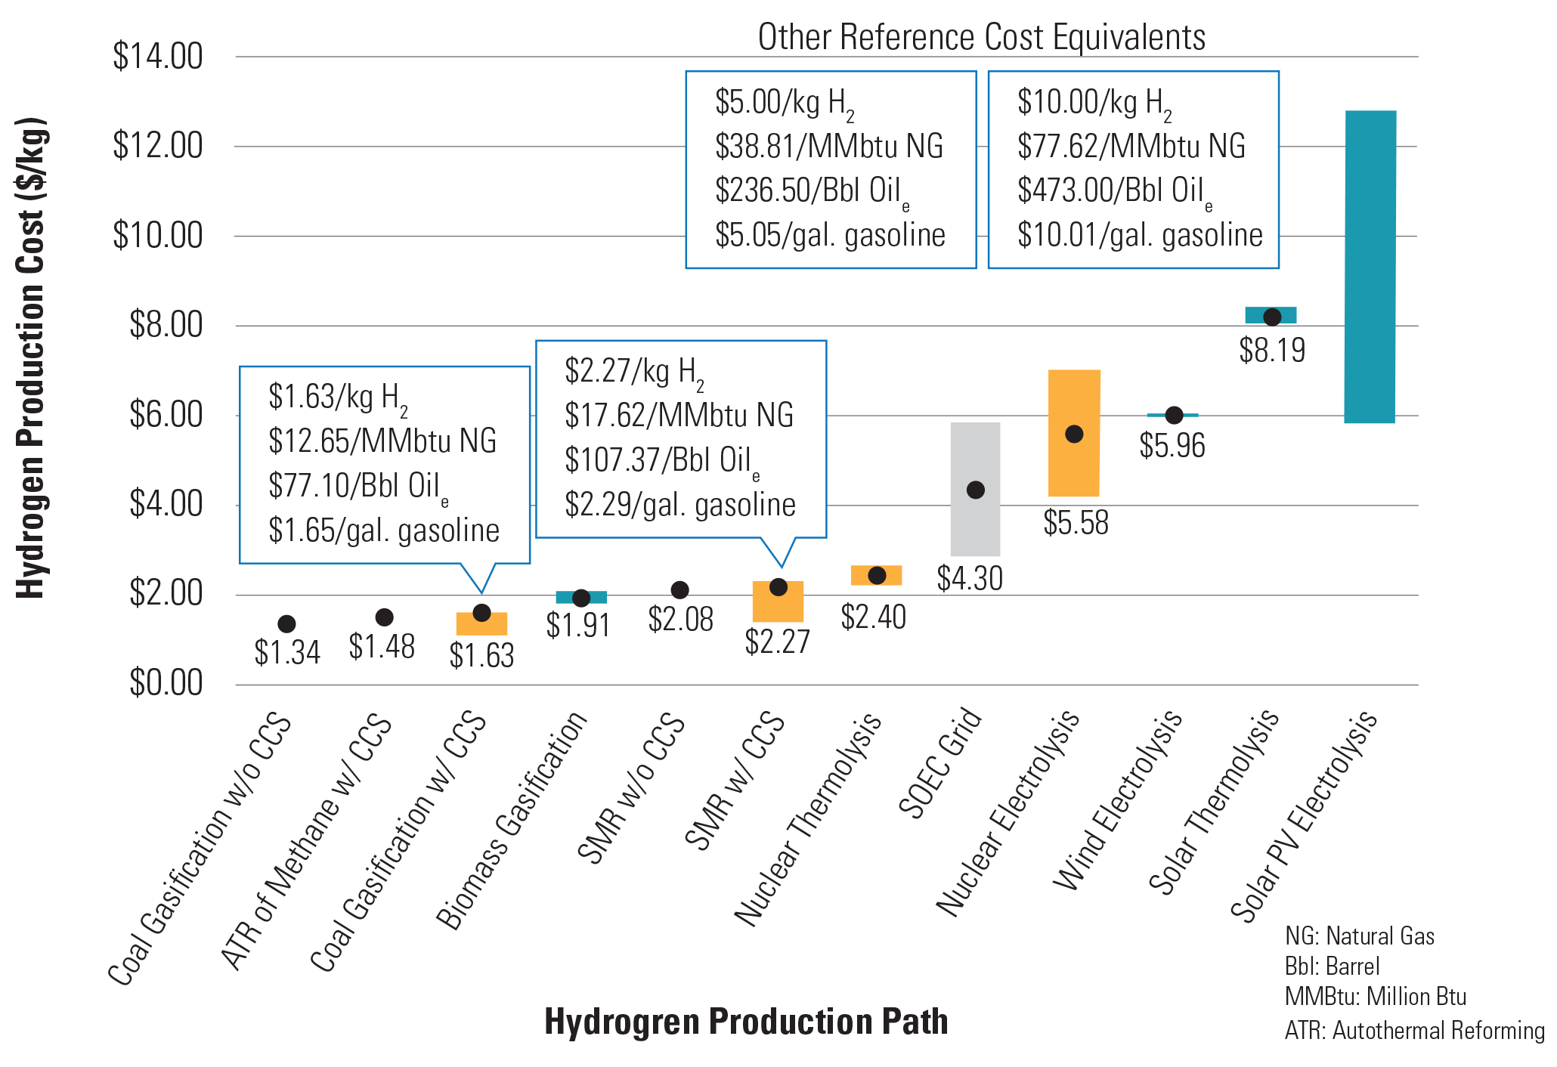
Hydrogen Challenges — Economic
Clean hydrogen is expensive. Costs must be reduced to reach ambitious cost targets.
Solar Hydrogen Production: Processes, Systems and Technologies, 1st Edition. Editors: Francesco Calise, Massimo Dentice D’Accadia, Massimo Santarelli, Andrea Lanzini, Domenico Ferrero. Academic Press. August 2019.
PNNL “H2 Hydrogen Tools.” Accessed online: https://h2tools.org/hyarc/calculator-tools/energy-equivalency-fuels
Notes:
Looking across various types of hydrogen production…
Fossil-based production processes are less expensive, but still high compared to gasoline and natural gas.
Costs here exclude hydrogen transportation and storage costs, which are also high.
For Reference: 1 kg hydrogen has the equivalent energy of about 1 gallon of gasoline (0.992 gal)
$1/kg H2 is about equal to $7.40/MMBtu on an energy basis (1 kg H2 = 0.1348 MMBtu, on an HHV basis)
(Natural gas costs $2-4/MMBtu now, but is carbon intensive)

Slide 11
Hydrogen Challenges — Environmental
Clean Hydrogen defined as producing <4 kg CO₂/kg H₂ in the Hydrogen Production Tax Credit, defined in Section 13204 of the Inflation Reduction Act
Excludes “credit stacking” with both 45V and 45Q, the CO₂ Sequestration Tax Credit
Consistent with draft Clan Hydrogen Production Standard
Includes “well-to-gate” GHG emissions
45V: Hydrogen Production Tax Credit
$$\frac{\text{kg} \text{CO}\text{2,}\text{e}}{\text{kg} \text{H}\text{2 }}$$ | Base Tax Credit | Meeting Labor Provisions*
<0.45 | $0.60/kg H₂ | $3.00/kg H₂
0.45 – 1.5 | $0.20/kg H₂ | $1.00/kg H₂
1.5 – 2.5 | $0.15/kg H₂ | $0.75/kg H₂
2.5 – 4.0 | $0.12/kg H₂ | $0.60/kg H₂
* Prevailing Wage and Apprenticeship Requirements

Slide 12
Fossil-Fueled Clean Hydrogen
Carbon capture and storage (CCS) effective at reducing stack emissions at the hydrogen plant
Need to reduce leakage from upstream natural gas system
Need to incorporate low-carbon electricity for hydrogen production
Biomass or RNG can offset GHG emissions
12
Notes:
BIL defines as producing 2kg of CO₂ per kg of H2 at the production plant.
Broader definitions being considered within the government.
Challenge to produce hydrogen with minimal GHG emissions

Slide 13
NETL’s Role
Production | Transport & Storage | Utilization | Systems Analysis
Enable a rapid, cost-effective transition to a hydrogen economy
Decades of research on carbon capture and storage (CCS) and large-scale fossil fuel production, infrastructure and power systems
Deliver solutions to challenging hydrogen R&D problems across the hydrogen value chain
13
Notes:
Enable a rapid, cost-effective transition to a hydrogen economy
Decades of research on carbon capture and storage (CCS) and large-scale fossil fuel production, infrastructure and power systems
Deliver solutions to challenging hydrogen R&D problems across the hydrogen value chain

Slide 14
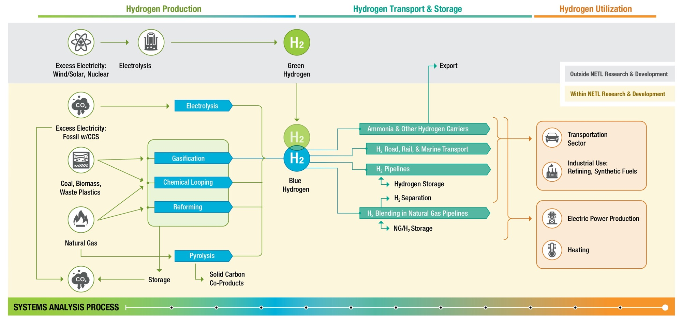
Notes:
Succinct explanation of how the Hydrogen system works together.
National buildout of a cost-effective hydrogen economy
Work with partners to leverage respective capabilities to the greater benefit of hydrogen R&D.
Commercialize innovative NETL hydrogen technologies.

Slide 15
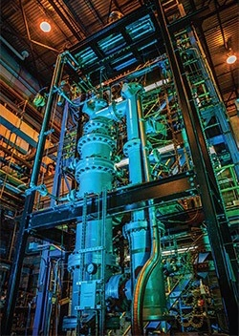
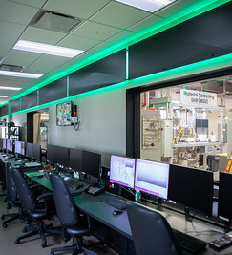
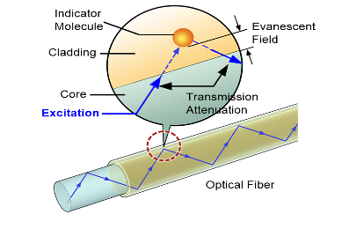
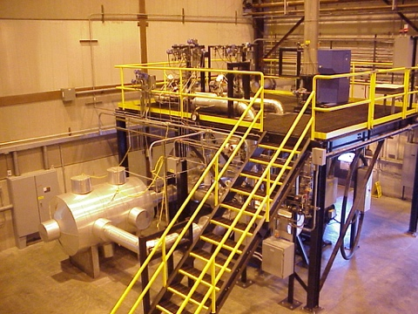
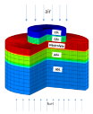
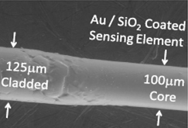
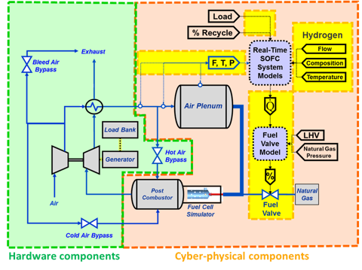
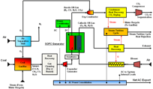
Innovation Across Hydrogen Value Chain
Technology Accelerator
Production
Transport & Storage
Utilization
Solid oxide electrolysis of water for hydrogen
Advanced natural gas reforming and gasification with CCS
Microwave-enabled modular ammonia production from hydrogen
Sensors for real-time pipeline monitoring and hydrogen safety
Operability of SOFCs with integrated energy systems
Hydrogen and ammonia gas turbine combustion
Distributed Fiber Optics Sensors for temperature, strain, gas chemistry, pH, corrosion, and acoustic vibration
LES Simulation of combustor flashback with increasing H2 content in natural gas
50 kW Chemical Looping Reactor
NETL’s ReACT Laboratory
Hybrid Performance Cyber-Physical Test Facility
Multi-scale SOEC Modeling
d
Strategic Systems Analysis
Notes:
These are some of our highest TRL technologies for hydrogen production, transport, and usage

Slide 16
Scaling H₂ Technologies with Systems Analysis
NETL has developed numerous tools to assist with managing the hydrogen value chain, from production, to transport and storage, to utilization, and for carbon emission management.
These tools assess:
Techno-economic and life-cycle analysis technology
Economic analysis
Resource availability
System design and optimization
Many tools are publicly available
TEA/LCA Tech Assessments
Economic Assessments
Resource Assessments
Design/ Optimization
Value Chain: | Production | Transport/ Storage | Utilization | CO₂ Management
Natural Gas Life-cycle Analysis
H₂ Pipeline Cost Model
CCSI²
H₂ Screen
Number of tools within
Fewer
More
Degree of relevance to planning H₂ Investment
Less
More
Notes:
Analyses Across Hydrogen Value Chain
Life-cycle analyses to determine the greenhouse gas emissions and water impacts of hydrogen pathways
Market competitive assessment of regional hydrogen infrastructure buildout and job impacts
Modeling and techno-economic analyses of plant and facility level. Impact of Inflation Reduction Act
Enterprise optimization to scale in technologies and users to meet life cycle targets and reduce risks
Optimal H2 and CO2 transportation and storage configurations ​

Slide 17
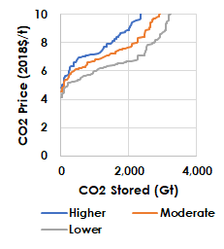
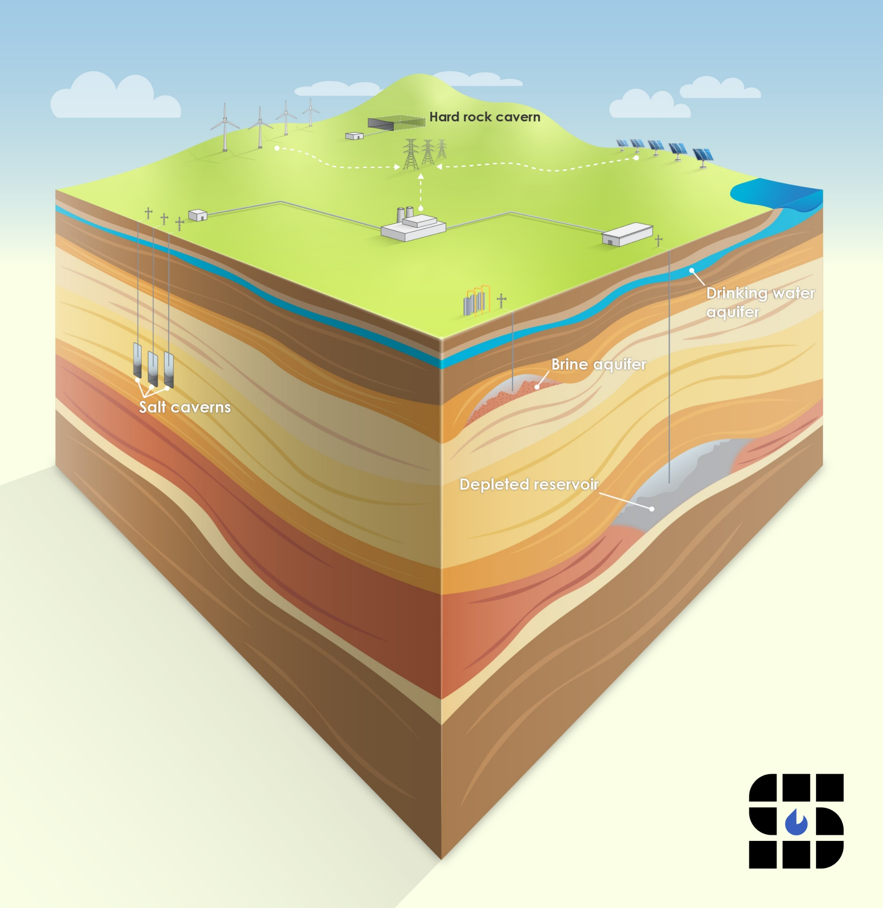
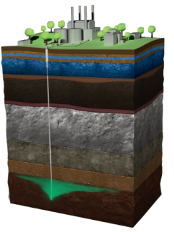
Optimizing Subsurface Storage
Leveraging CO₂ Transport & Storage Capabilities for Hydrogen
CO₂ and H2 Infrastructure Literacy
CO₂ & H₂ Transport
CO₂ & H₂ Storage
CO₂ Screen, H₂ Screen
U.S. storage capacity of formations (saline, salt and depleted wells) with economic implications
H₂ under development (2023)
Onshore CO₂ Pipeline Transport
FECM/NETL CO₂ Transport Cost Model
Publicly Available:
https://netl.doe.gov/energy-analysis/details?id=543
Tool to calculate the technical performance and costs of transporting CO₂ by pipeline
Onshore CO₂ Storage
FECM/NETL CO₂ Saline Storage Cost Model
Publicly Available:
https://netl.doe.gov/energy-analysis/details?id=2403
Carbon Storage Atlas
A coordinated update of carbon capture and storage (CCS) potential across the United States
https://netl.doe.gov/carbon-storage/risk integration/publications#collapseFE0031888
H₂ Storage
H₂ Subsurface Storage Cost Model
Under development
Regional H₂ Market Analysis
How to grow a hydrogen economy in a region – Appalachia (2022):
Public Report
Also assess Appalachia H₂costs in geologic ethane storage reservoir​
H₂ Pipeline Transport
FECM/NETL Hydrogen Pipeline Cost Model (H2_P_COM)
And accompanying models
Near completion
National Risk Assessment (NRAP)
Demonstrate CO₂ and H₂ Subsurface Risks
via EDX:
https://edx.netl.doe.gov/nrap/
Focus of subsurface team modeling effort

Slide 18
Bipartisan Infrastructure Law (BIL)
$9.5B for clean hydrogen:
$8B for at least four regional clean hydrogen hubs
$1B for electrolysis RD&D
$500M for clean hydrogen technology manufacturing and recycling R&D
Aligns with Hydrogen Shot priorities to reduce the cost of clean hydrogen to $2 per kilogram by 2026
Requires developing a National Hydrogen Strategy and Roadmap
18
Notes:
Hydrogen highlights.
Hub Definition: a network of clean hydrogen producers, potential consumers, and connective infrastructure located in close proximity.
Hubs required to reflect diversity in feedstock, end users, geography, some natural gas and to create jobs.

Slide 19
Regional Clean Hydrogen Hubs FOA 2779
Compulsory deliverables for anticipated 6-10 hydrogen hubs
Concept Papers due 11/7/22
Phase I (Applications due 4/7/23)
Detailed Project Planning $20 million ($40 million w/ cost share)
12-18 months preplanning
Phase II-IV
Project Development, Permitting, Financing (2-4 years)
Installation, Integration, Construction (2-4 years)
Ramp up and Sustained Operations $400 million - $1.25 billion from planning to commission
50% Cost Share in all Phases
Path to reduced production costs and a minimum 50-100 MT/d hydrogen production hurdle
$1 per kg H₂ not a requirement, but a goal
Path to reduced carbon emission levels require improvement scenarios
LCA/TEA required
Need to show progress in reducing GHG emissions
Plan viable hydrogen transportation and storage that connects identified & committed users
CO₂ transport & storage plan if fossil based
Ready workforce and justice to underserved communities and regional stakeholders
Notes:
(6-10 initial awardees) Phase I
2-3 years (at least 4 awardees) Phase II
There were material shifts between the RFI and the planned FOA (described in the NOI).
-$10 million per team in phase (was $1-4 million in the RFI)
-the NOI (single lead) and this attached chart suggest you want to be proposing now for Phase I . NOI does note at end that some funds may be held back for later teams (up to 25% of $8 Bn. DOE expects 6-10 hubs in initial launch.
--maintained 12-18 month 1s for phase 1
-50% cost share (which if we compete will will need someone else to pick up our share)
-Phase 2 downselect is then for 2-3 years (was upwards of 5 years), then Phase 3, Phase 4. -total period is shown as 8-12 years (the BIL was 5 year period)
-max carbon intensity < 2 kg CO2e/kg which looks from recent Tim Skone work that ATR w. CCS would not be sufficient - NOI states LCA for each application will be full reviewed (expect this is a clearinghouse role). "It is envisioned that each hub will quantitatively estimate and measure LCA impact on the region (industry role?)
-the only NOI mention of CO2 capture and storage is related to fossil H2 production (not an emphasis topically)
-min 50-100 MT per day production
-production cost < $2 per kg H2 by 2026 , <$1 per kg H2 (decade).
-the role of the clearinghouse is touched on by claiming project data is expected to be accessed by DOE. I was a bit surprised by this following statement " AS these are pre-commercial project deployments, project progress and info will be shared with interested stakeholders.
-FOA include all 4 phases of the project (vs. just info for phase I)? Would love Nate's thoughts on the choice of words here.
-Expected concept paper 6-8 weeks after FOA. Full applications 4 months after selection of concept paper.
For us, our value proposition is baked in to the needs of this NOI
-they need TEA/LCA during application phase (now) and revised in later phases
-they need a workforce plan
-they need a total cost project estimate (disadvantage for Appalachia where there is not a clean single project like building a new production plan)
-favor disadvantaged communities plan
-full supply chain of production, transport, storage, users must be detailed.

Slide 20
The Hydrogen Hub Concept

Slide 21
THANK
YOU!
VISIT US AT: www.NETL.DOE.gov
@NETL_DOE
@NETL_DOE
@NationalEnergyTechnologyLaboratory
CONTACT:
Nathan Weiland, Ph.D.
Senior Fellow – Energy Conversion Engineering 412-386-4649 Nathan.weiland@netl.doe.gov

