Slide 1
What Actions, If Any, Should Appalachia Governors Take to Support Hydrogen Hubs in Their States? Keynote Presentation - Harnessing Hydrogen: Exploring Local & Regional Opportunities in Appalachia Policy, October 4, 2022, Washington & Jefferson College Center for Energy Policy and Management
Deborah D. Stine, PhD
Founder, Science and Technology Policy Academy
Deborah@scitechpolicyacademy.com
www.scitechpolicyacademy.com

Slide 2
“Dedicated local leadership is a key element of success for regional innovation efforts.”
https://www.csis.org/analysis/making-hydrogen-hubs-success
https://nap.nationalacademies.org/catalog/18364/best-practices-in-state-and-regional-innovation-initiatives-competing-in

Slide 3
Making policy is really difficult
No policy will ever be perfect
Policy makers can be expert too
Policy makers are not a homogenous group
Policy makers are people too
Policy decisions are subject to extensive scrutiny
Starting policies from scratch is very rarely an option
There is more to policy than scientific evidence
Public opinion matters
Policy makers do understand uncertainty
Policy and politics are not the same thing
Policy and science operate on different timescales
'We need more research' is the wrong answer
https://www.theguardian.com/science/2013/dec/02/scientists-policy-governments-science

Slide 4
Policy Analysis Steps
Define the problem
Assemble the evidence
Construct the alternatives
Select the criteria
Project the outcomes
Confront the trade-offs
Decide
Tell your story

Slide 5
Step 1: Problem Identification Step 2: Assemble the Evidence
Identify the true, underlying problem
Frame the problem accurately
Keep in mind the context of the problem
Talk to the stakeholders affected by the problem
Talk to those responsible for the existing policy
Conduct a literature review
Be specific
https://www.cdc.gov/policy/polaris/policyprocess/problem_identification.html

Slide 6
Step 3: Construct the Alternatives: Policy Option Identification Steps
Develop Your Information Base
1
Identify Stakeholders and Their Position
2
Brainstorm Ideas
3
Pick Two Alternatives to the Status Quo
4

Slide 7
Brainstorm Ideas Considering These Policy Alternatives
Taxes
Education and Consultation
Financing & Contracting
Bureaucratic Reform
Regulation
Subsidies and Grants
Service Provision
Agency Budgets
Economic Activity
Source: Bardach, E., “A Practical Guide to Policy Analysis” at http://www.cqpress.com/product/Bardach4e.html.
7
https://www.youthopiabangla.org/skillDoc/Advocacy-Tool-Kits/Adv_Policy_Analysis_8_fold_path_Eugene_Bardach.pdf

Slide 8
Step 4: Policy Option Evaluation Criteria (the 4 E’s)
EFFECTIVENESS:
EFFICIENCY:
EQUITY:
EASE OF POLITICAL ACCEPTABILITY:
What is the cost of the current policy?
What is the cost of the proposed policy relative to its expected benefits?
Is the proposed policy the “best bang for the societal buck”?
Is the policy option fair or equitable?
Who are the winners?
Who are the losers?
How will government officials and other policy actors appraise the proposed policy?
Will there be too much opposition?
Will there be too little support?
How likely is the policy to reach the societal goal?
How likely is the policy to reach the societal goal?
Is the policy or program considered likely to work better than the current policy (status quo)? If so, by how much?

Slide 9
Step 5: Project the Outcomes Which policy option is the most desirable given the circumstances and the evaluative criteria?
Public Policy by Michael E. Kraft and Scott R. Furlong

Slide 10
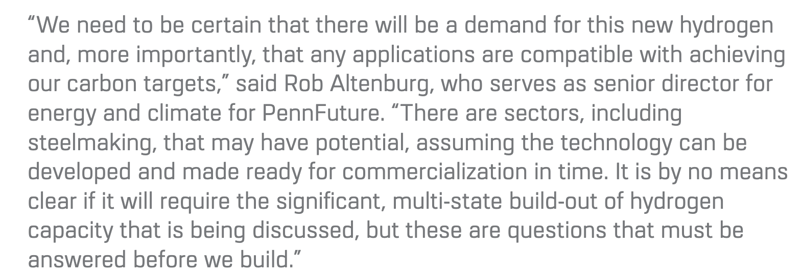
Effectiveness: Will the Hydrogen Hubs be Effective Relative to Other Options to Reduce Greenhouse gas Emissions?
Efficiency: Do the Benefits Outweigh the Costs?
https://www.pahouse.com/InTheNews/NewsRelease/?id=125657

Slide 11
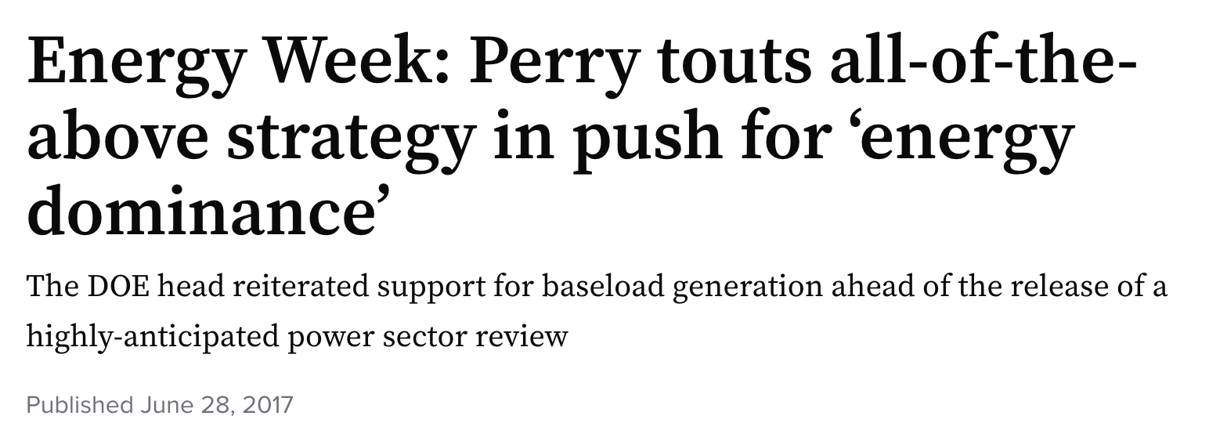
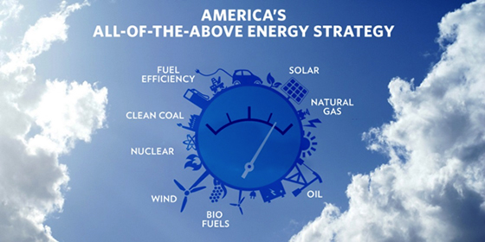
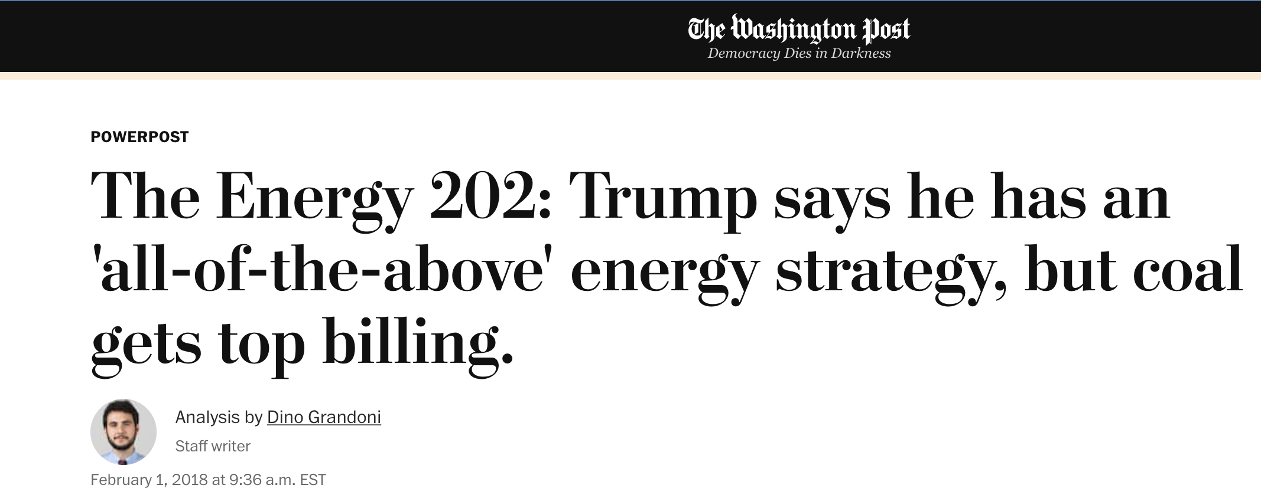
Equity: Who are the Winners and Losers?
https://www.washingtonpost.com/news/powerpost/paloma/the-energy-202/2018/02/01/the-energy-202-trump-says-he-has-an-all-of-the-above-energy-strategy-but-coal-gets-top-billing/5a71f62c30fb041c3c7d7550/
https://obamawhitehouse.archives.gov/energy/securing-american-energy
https://www.utilitydive.com/news/energy-week-perry-touts-all-of-the-above-strategy-in-push-for-energy-domi/446052/
https://obamawhitehouse.archives.gov/blog/2014/05/29/new-report-all-above-energy-strategy-Path-sustainable-economic-growth

Slide 12
1. Think ahead about how to reduce hydrogen and methane leakage.
2. Dedicate funding for sensor technologies.
3. Think holistically about what constitutes “clean hydrogen.”
4. Prioritize hydrogen for difficult applications, where today’s solutions are insufficient.
5. Don’t slow progress in building a clean power sector.
6. Conduct research into environmental, health and social consequences, and set necessary protections.
7. Support the community.
8. Follow through on community engagement commitments.
9. Be transparent.
Ease of Political Acceptability: Who will strongly support & oppose the policy?
https://blogs.edf.org/climate411/2022/08/24/9-recommendations-for-getting-us-hydrogen-hubs-right-from-the-start/

Slide 13
Anticipate possible undesirable side effects. - “unanticipated consequences”

Slide 14
Step 6: Confront the Tradeoffs Step 7: Decide!
Imagine you are the policymaker. What questions do you think they would ask you about your recommendation?
Imagine the policymaker hires you to staff the initative. What would you want to know?

Slide 15
Step 8: Communicate Your Results
Public Policy Analysis
Policy Position Article
Policy Pitch
Policy Brief
Policy Neutral Report
Info Graphic
Transition Paper
Video
Analysis Picture Source: http://www.atlas101.ca/pm/concepts/policy-analysis/

Slide 16
What Actions, If Any, Should the Appalachia Governors Take to Support Hydrogen Hubs in Their States?

Slide 17
Option 1: Incentivize Clean Hydrogen Markets
Establish State procurement policies
Regulate Utilities
Set Decarbonization Commitments
Identify sector specific targets
https://www.csis.org/analysis/making-hydrogen-hubs-success

Slide 18
Option 2: Build Hydrogen Hub Innovation & Infrastructure
Cluster
Build Regional Innovation Cluster
Construct
Plan, Construct, Finance Physical Infrastructure linking production, storage and transportation facilities, and end users
Cooperate
Cooperate as a Tri-State Region of Ohio, Pennsylvania, & West Virginia
https://www.csis.org/analysis/making-hydrogen-hubs-success

Slide 19
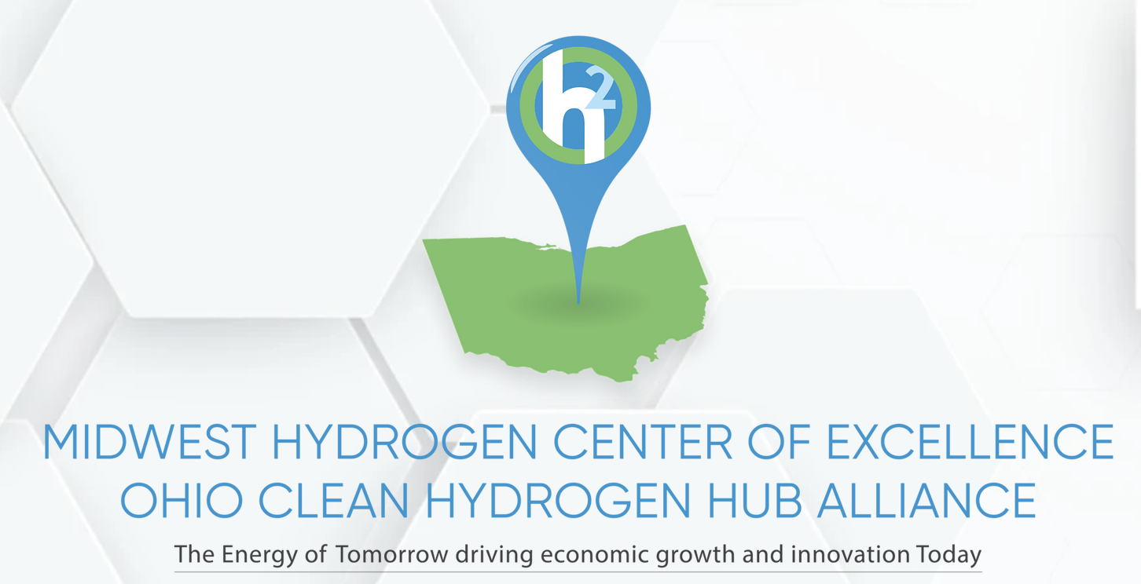
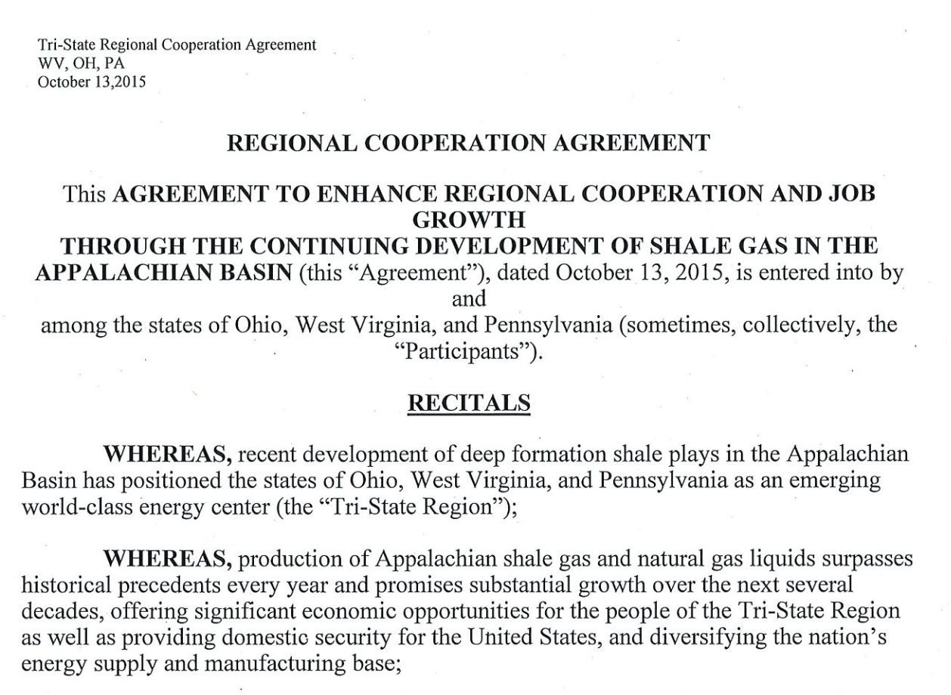
Should the Tri-State Region Work Together?
Connecticut, New York, New Jersey, and Massachusetts
Louisiana, Oklahoma, and Arkansas
Colorado, New Mexico, Utah, and Wyoming
Maine and Rhode Island

Slide 20
Option 3: Develop Skilled Clean Hydrogen Technical Workforce
Enhance
Enhance Strategies to Help Students Complete Their Technical Training
Incentivize
Incentivize Curriculum Development & Technical Ed Quality Improvements
Improve
Improve Labor Market Information for Workers
Remove
Remove Barriers to Worker Mobility with Transferrable Credentials
Identify
Identify how clean-hydrogen job programs include disadvantaged communities
https://www.csis.org/analysis/making-hydrogen-hubs-success
https://nap.nationalacademies.org/catalog/23472/building-americas-skilled-technical-workforce

Slide 21
Option 4: Attract Private and Public Capital Beyond DOE Startup Funds
Provide tax incentives to attract investment for hydrogen takers
Recruit experts in public/private financing to encourage investment
Design to attract climate-focused investments
https://www.csis.org/analysis/making-hydrogen-hubs-success

Slide 22
Option 5: Establish H2 Hub Governance to Monitor Achievement Targets
Reduce Lifecycle CO2 and Monitor Hydrogen & Methane Leaks
Prioritize Hydrogen Use for Hard-to-Abate CO2 Emissions
Consider Electric Grid System Decarbonization Impacts
Analyze Environmental, Health, and Social Community Impacts
Follow-Through on Community Engagement Commitments & Be Transparent
Support Job Creation and Economic Development
https://blogs.edf.org/climate411/2022/08/24/9-recommendations-for-getting-us-hydrogen-hubs-right-from-the-start/
https://www.csis.org/analysis/making-hydrogen-hubs-success

Slide 23
Option 6: Avoid Local Community Challenges That Resulted from Shale Era State Policies
No unfunded mandates from the state to local communities
No permitting responsibilities at local government level
Provide conflict resolution support at state level to manage company-landowner and landowner-landowner relations and disputes
Require companies report status on employment and other community promises

Slide 24
Based on the 4E Criteria How Would You Rank Options? (Effectiveness, Efficiency, Equity, Ease of Political Acceptability)
Option 1: Incentivize Clean Hydrogen Markets
Option 2: Build Hydrogen Hub Innovation & Infrastructure
Option 3: Develop Skilled Clean Hydrogen Technical Workforce
Option 4: Attract Private and Public Capital Beyond DOE Startup Funds
Option 5: Establish H2 Hub Internal Governance to Monitor Achievement Targets
Option 6: Avoid Local Community Challenges That Resulted from Shale Era State Policies
Option 8: No Action Needed
Option 7: My Own Idea

